Slide 1
Build your first ML Model
Robin Rojowiec & Maike Havemann

Slide 2
Agenda
What is ML ?
Algorithm and Dataset
Setup your Environment
Getting Started

Slide 3
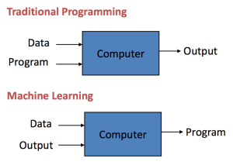
What is ML ?
Notes:
Source: https://machinelearningmastery.com/basic-concepts-in-machine-learning/

Slide 4
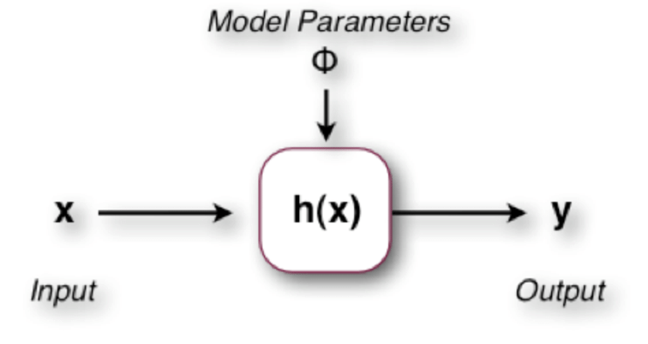
What is ML ?
Notes:
Source: https://www.researchgate.net/figure/A-machine-learning-algorithm-expressed-as-a-function-h-x-with-input-x-output-y-and_fig1_230691317

Slide 5
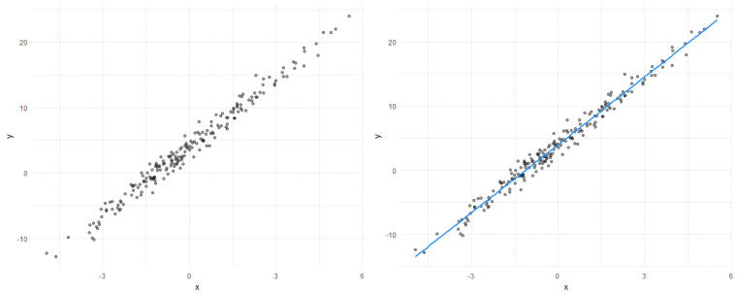
What is ML ?
Notes:
Source: https://towardsdatascience.com/machine-learning-fundamentals-via-linear-regression-41a5d11f5220

Slide 6
What is ML ?
Notes:
Source: https://towardsdatascience.com/machine-learning-fundamentals-via-linear-regression-41a5d11f5220

Slide 7
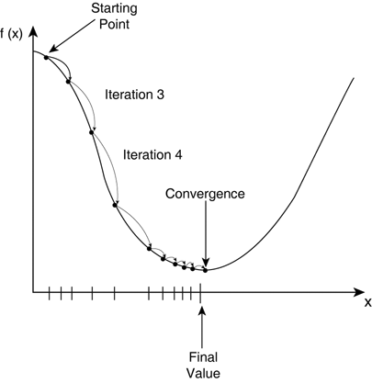
How do we get there ?
Error
Parameter Values
Notes:
Source: https://towardsdatascience.com/machine-learning-fundamentals-via-linear-regression-41a5d11f5220

Slide 8
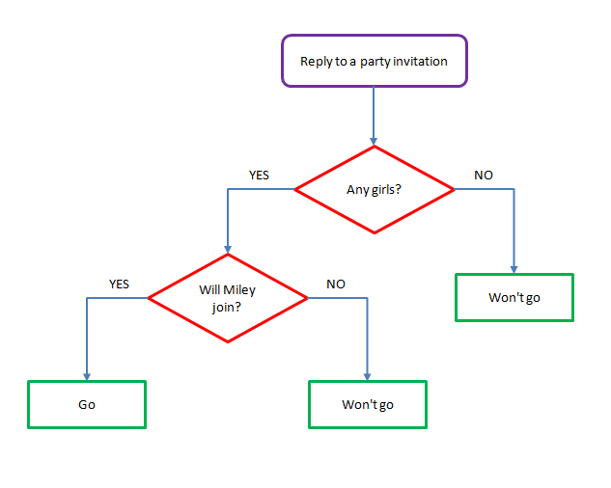
Algorithm: Decision Tree
Notes:
Source: https://chunml.github.io/ChunML.github.io/tutorial/Decision-Tree/

Slide 9

Algorithm: Decision Tree
Notes:
Source: https://towardsdatascience.com/decision-trees-in-machine-learning-641b9c4e8052

Slide 10
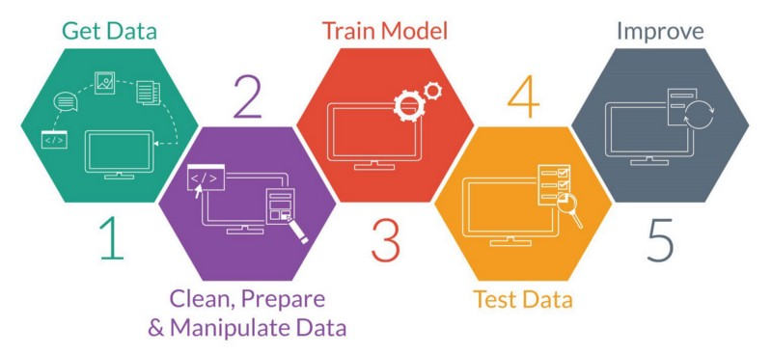
Getting started
Notes:
Source: http://www.houseofbots.com/images/news/3581/cover.png

Slide 11
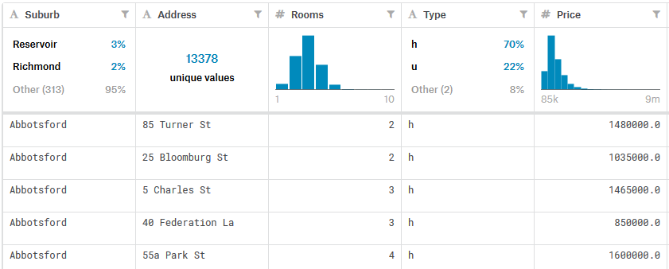
Dataset: Houses in Iowa
Notes:
Source: https://www.kaggle.com/dansbecker/your-first-machine-learning-model/data

Slide 12

Setup Environment
What we will use today:
Google Collab with integrated Jupyter Notebooks
Notes:
Source: https://nholmber.github.io/2018/09/google-colab/

Slide 13
Which frameworks and language we will use
Python 3.5+
Pandas
SciKit-Learn
Notes:
Source: https://www.kaggle.com/iorideepp/your-first-machine-learning-model

Slide 14
Setup Environment
Start the laptop and login
Open the public respository: https://github.com/RobinRojowiec/your-first-model-ml-intro
If you don‘t have a google account, create one here: https://accounts.google.com/signup
Login to Google Collab: https://colab.research.google.com/
Import the Notebook from Github:
Goto File->Open Notebook
Select Github
Paste the following URL:
Press Upload

Slide 15
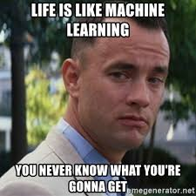
Let‘s go!
Instructions
Follow the instructions in the Notebooks. This presentation is available on the Github Repository if you need it.
We will do checkpoints every 15 Minutes to check where you are.
If you need help, raise your arm.
Notes:
Source: https://memegenerator.net/instance/74155978/forrest-gump-life-is-like-machine-learning-you-never-know-what-youre-gonna-get

Slide 16
Any Questions ?

